Slide 1
Your Personal
Development
2
Standard

Slide 2
Learning outcomes
2.1 Agree a personal development plan
2.2 Develop knowledge, skills and understanding.
2
Standard

Slide 3
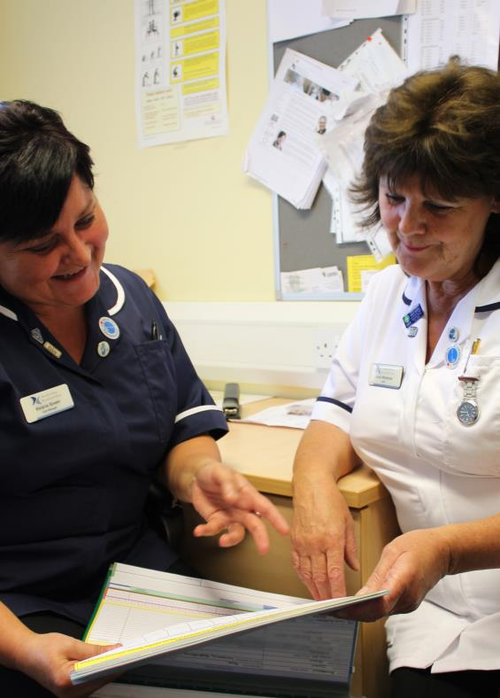
Skills, knowledge and competence
Skills, knowledge and competence need to be developed throughout your working life.
A Personal Development Plan (PDP) sets out the areas you need to develop and how to go about achieving this.
Personal Development Plans (PDPs) identify:
The areas you need to develop
What you want to achieve
How and when you will achieve it.
Notes:
Development areas
Knowledge and skills that must be developed for workers to carry out their role competently.
Examples of reasons why these could arise include:
Changes in legislation
Changes to organisational policies or procedures
Changes in job role
Support needs of individuals they support.
Objectives - What you want to achieve
Objectives should be - SMART
Specific
Measurable
Achievable
Relevant
Time-based.
How and when you will achieve your objectives
There are many different ways of developing knowledge and skills including:
Internal opportunities – training courses, mentoring and shadowing, guidance in supervision, team meetings
External opportunities – websites, online forums, social media, books, journals, training courses, online learning opportunities, speaking to workers in different roles.

Slide 4
Contributing to your PDP
To get the most out of a PDP workers should be prepared to contribute to the discussion. Workers should ask themselves:
Do I have the skills and knowledge that I need for my current role?
What development opportunities are available
in my role?
What are my ambitions and goals?
Am I making the right choices to get me there?
Notes:
Skills and knowledge required for a role will be set out in:
The relevant standards for the role
The worker’s job description.
A PDP is important to:
Ensure that a worker’s skills, knowledge and understanding meet the requirements of their role
Develop the worker’s skills and help their career progression.

Slide 5

Agreeing a personal development plan
Step 1
Step 2
Step 3
Agreeing your aims and objectives
Plan activities to meet the objectives
Set timescale to achieve outcomes
and review
The following people will be involved…
You
Your manager
The following people will be involved…
You
Your colleagues
Trainers
Mentors
The following people will be involved…
You
Your colleagues
Your manager
Notes:
QUESTION:
Ask the group/individual to think about how to create a personal development.
Step 1. Agree objectives
Example: Be able to write and review care plans with the individuals who receive care and support in my workplace.
Step 2. Plan activities to meet the objectives
Example:
Read the instructions and look at the layout for care planning in my workplace
Discuss these and ask questions of an identified more experienced worker
Examine and discuss three examples of care plans with the individuals concerned with their permission, and discuss any changes they might like to make
Report back to your manager and discuss any questions or learning points.
Step 3. Set timescales to achieve outcomes and review
Timescales - one of the four activities listed will be achieved each week so this will take four weeks.
Outcome - Discuss the three steps and possibly update ‘care plans’ with your manager and review your learning.

Slide 6
Core skills are…
Literacy
Numeracy
Communication skills
Reading and contributing to care plans
Recording data clearly
Filling out forms
Writing emails
Taking notes
Reading and understanding agreed ways of working
Recording a person’s temperature or blood pressure
Monitoring weight loss or weight gain
Recording the amount of fluids drunk
Measuring medicine dosage
Discussing care and support with individuals
Discussing tasks with your manager or with colleagues
Discussing and agreeing your Personal Development Plan with your manager
Participating in team meetings, supervision and appraisal
Materials are available on and offline to check and develop
core skills.
Notes:
Materials are available on and offline to check and develop core skills.

Slide 7

Reflection
Reflecting on past experiences can help to continually develop skills and understanding.
  Carry out a task
  Look back on a situation or activity
  Think about what was done and what happened
  Think about what you could do differently.
Notes:
Activity
Ask the worker/s to think about a time when they did something (at work or at home) that didn’t work out quite as they would have liked it to.
Ask the worker/s to think about exactly what they did and what happened.
Ask them to consider how what they did/what they said/how they responded to others affected the situation.
Ask them to think about what they would do differently if they were to come across a similar situation in the future.
Explain that reflection and learning from past experiences is a form of development. Developing skills in this way is an example of how a learning activity has changed the way they work and improved their skills, knowledge and understanding of their role.

Slide 8
Feedback
Feedback from others can help you to understand what others think of the way that you work.
Formal
Informal
Formal feedback is usually given in writing. This might be part of an assessment or appraisal or on a comments sheet.
Informal feedback happens in
day-to-day discussion with work colleagues, managers or the individuals that you provide care and support for.
Feedback should be:
Timely
Positive
Constructive.
Notes:
Feedback should be:
Timely – Given as soon as possible after the event when it is still fresh in the mind.
Positive – Focusing on improving work performance rather than on personal factors (e.g. intelligence or confidence).
Constructive – Based on facts and actual events.

Slide 9

Continuing professional development
Continuing Professional Development (CPD) is the ongoing process of updating skills and knowledge.
  Induction
  Ongoing development
  Refresher training
Completed development should be recorded in a CPD record.
Notes:
Induction – Completed in the first 12 weeks
Ensures that workers have the appropriate basic skills and knowledge they need to be competent in their role and in their specific workplace. Examples of what will be included in induction are:
Work place induction – covering the policies and procedures that apply in the workplace including Health and Safety, Fire Safety, and the specifics of the role
Care Certificate – sets out the values, abilities and behaviours that are required to be a Health or Social Care Worker providing good quality, compassionate care.
Ongoing development
Needed to enable workers to meet changing requirements because of:
Changes to legislation
Changes to agreed ways of working
Changes to their job role and what is required of them.
Specialist training – specific to the requirements of each role and workplace.
Reflective practice/Reflection – learning from experience
Refresher training
Some training needs to be repeated regularly to ensure that high-risk tasks are completed safely
Examples include:
Moving and Assisting, Moving and Handling, Moving and Positioning
First Aid Training
Medication training
Fire Safety

Slide 10







Knowledge check
Why is it important for workers to continually develop their skills, knowledge and understanding?
Click to reveal answer
It gives managers something to discuss in appraisal
It is a way of competing with colleagues
It ensures that skills and knowledge are up to date
It sets out learning goals and objectives
Notes:
QUESTION:
Ask group question then to answer A,B,C or D
Trainer should ask class why they chose the correct answer.
Feedback
A – Managers will discuss often discuss a development plan in a worker’s appraisal but this is not the main reason for continually developing skills and knowledge.
B – Workers should cooperate and work together to provide the best standard of care to the individuals they support. Learning and development is not a way of competing with colleagues.
C – Developing skills, knowledge and understanding on a continuing basis is the best way for a worker to ensure that their skills and knowledge are up to date and that they can do their job safely and effectively.
D – A record Continuing Professional Development (CPD) is where a worker should record their completed learning and development activity. Learning goals and objectives should be recorded in a Personal Development Plan (PDP).

Slide 11


Knowledge check
What is the main way that a learning activity can
improve your work?
Click to reveal answer
Using what you learn can improve the standard of care that you provide
Having a break from work helps you to manage your stress
It gives you an opportunity to get to know your colleagues
It confirms that you do not need to develop your skills and knowledge any further
Notes:
QUESTION:
Ask group question then to answer A,B,C or D
Trainer should ask class why they chose the correct answer.

Slide 12


Knowledge check
What does ‘reflection’ involve?
Click to reveal answer
Agreeing a Personal Development
Plan with your manager
Asking your colleagues what they think of the way that you work
Giving constructive feedback to your colleagues
Learning from what you have done in the past to improve the way you will work in the future
Notes:
QUESTION:
Ask group question then to answer A,B,C or D
Trainer should ask class why they chose the correct answer.
Feedback
A – Agreeing a PDP is part of an ongoing process of learning and development to improve your skills and knowledge which may be informed by you reflecting on your own practice.
B – Feedback from others can be helpful in developing your skills and knowledge but it is not part of reflection on your own work.
C – Giving constructive feedback to others can help them to improve the ways in which they work but it is not part of reflecting on your own work.
D – Reflection is a form of learning and development in which workers think about what they have done in the past. By thinking about how they could have done things differently to get a different result, they can learn from past experiences and improve the ways in which they work.

