Slide 1
Handling information
14
Standard

Slide 2
Learning outcomes
14.1 Handling information
14
Standard

Slide 3
Handling information
The information about an individual's care and support may be personal and sensitive. This information must be treated as confidential and only shared with people who need to know.
Respecting confidentiality is:
A legal requirement
Essential to promote the individual
An important part of building trust.

Slide 4
Information sharing
Information can be shared with people who need-to-know.
Which of the people below would ‘need-to-know’ about an individual’s care and support needs?
✓
Yes
X
No
The individual’s neighbour
X
A health and social care worker who is involved in providing care
✓
The individual's family or friends
X
The worker’s family or friends
X
A health and social care worker not involved in providing care to the individual
X
A worker in a different role who is involved in providing care to the individual
✓
Notes:
Activity
Ask health and social care worker/s which of the people identified in the table would ‘need-to-know’ about an individual's care and support needs.
Additional information
Care must be taken to store information carefully to avoid unauthorised people accessing personal or sensitive information.
Electronic information should be password protected
Consideration should be given to who can overhear information being shared verbally
Paper records should be stored in locked cupboards or filing cabinets
Consent should be sought from the individual before information is shared.
In instances where an individual may come to harm information must be shared with the health and social care worker’s manager even when consent is not given.

Slide 5
Social media
The internet enables sharing of information through social media such as ‘Facebook’ and ‘Twitter’
Mobile internet technology makes it possible to share information instantly increasing the risks of breaching confidentiality.
Notes:
Additional information
Sharing an individual’s information on social media is as much of a breach of confidentiality as:
Leaving a record out of the locked filing system
Remaining logged in to a computer when workers are not present
Discussing an individual’s care and support where others can overhear.

Slide 6
Data Protection Act
The Data Protection Act 1984 introduced rules on the storage and use of information. The Act was revised in 2003 to include paper-based filing systems data.
1. Must be processed in a fair and lawful way
2. Can only be processed for limited purpose, e.g. in a way previously specified that you have consented to
3. Have to be relevant, adequate to their intended use and kept to a minimum
4. Have to be accurate and up-to-date
5. Should not be kept for longer than necessary
6. Should be processed in accordance with your rights
7. Should be stored securely
8. Should not be transferred to other countries where there is no adequate protection in place.
Notes:
Additional information
The Data Protection Act covers data which can be used to identify a living person including:
Names
Birthday and anniversary dates
Addresses
Telephone numbers
Fax numbers
Email addresses etc.

Slide 7
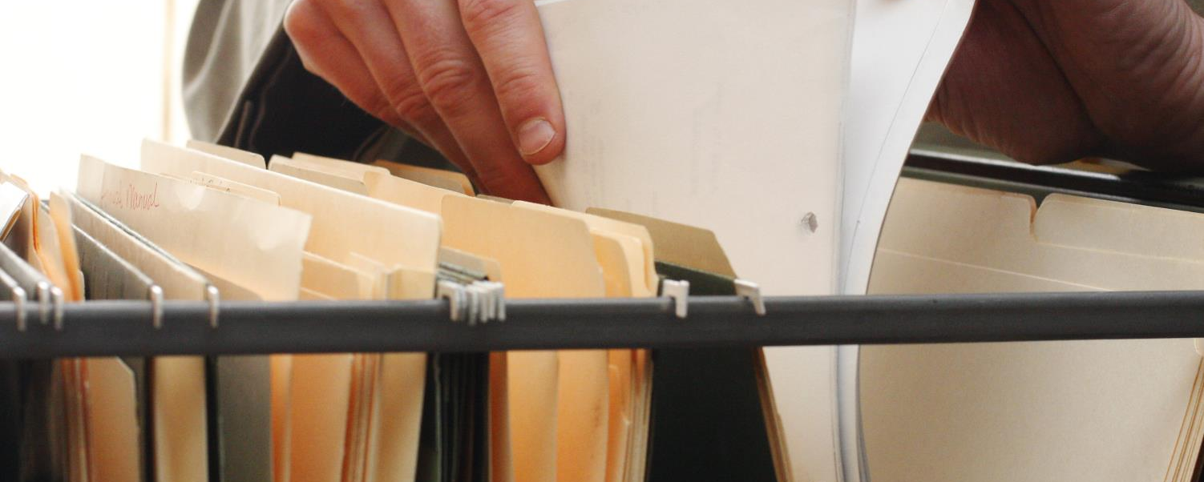
Freedom of Information Act
The Freedom of Information Act and the Environmental Information Regulations allow members of the public to access recorded information held by public authorities in England, Northern Ireland and Wales.
Notes:
Additional Information
Under the Act, a public authority includes:
Central government and government departments
Local authorities
Hospitals, doctors’ surgeries, dentists, pharmacists and opticians
State schools, colleges and universities
Police forces
Prison services.

Slide 8
Handling information in health and social care
You must always work in agreed ways that protect information
Examples of policies and procedures which protect information include:
Computer firewalls
Secure storage of keys
Office security codes
Not sharing passwords with unauthorised people
Locked filing cabinets and cupboards
Password protection
Security fobs or cards to access secure areas
Notes:
Activity
Ask health and social care worker/s to identify some security measures that are in place to protect personal and sensitive information.
Answers could include:
Computer firewalls
Password protection
Not sharing passwords with unauthorised people
Locked filing cabinets and cupboards
Secure storage of keys
Office security codes
Security fobs or cards to access secure areas

Slide 9
Care plans
Care plans are an important tool in good communication between those involved in providing care and support.
In order to ensure quality and consistency of care they must be:
Kept up to date
Complete
Accurate
Legible
Factual (without opinion)
Free from jargon.
Notes:
Additional information
They may become legal documents of evidence if at any point there is cause for concern or an enquiry.
Someone in the workplace will have the responsibility for checking care plans regularly to ensure they are fit for purpose.

Slide 10
Reporting concerns
Concerns about the recording, storing or sharing of information should be reported to your manager.
Confidential files being left around
A missing key to a cabinet containing confidential files
Passwords being shared with unauthorised people
Personally identifiable information being shared on social media
Workers discussing an individual in the pub.
If your concerns are not taken seriously you have a duty to report incompetent or unsafe practice to the regulatory body.
Notes:
Activity
Ask health and social care worker/s to give some examples of practices relating handling information that should be reported to your manager.
Answers could include:
Confidential files being left around
A missing key to a cabinet containing confidential files
Passwords being shared with unauthorised people
Personally identifiable information being shared on social media
Workers discussing an individual in the pub

Slide 11
Knowledge check
What type information does the ‘Data Protection Act’ apply to?
Click to reveal answer
Spoken information
Information which is given in training sessions
Electronic files and organised, paper filing systems
Information that does not identify individuals
Notes:
Trainer should ask class why they chose the correct answer.
Feedback
A – The Data Protection Act 1984 as amended in 2003 applies to Electronic files and organised, paper filing systems that includes personally identifiable information. Spoken information is not included but confidentiality can be breached if personal or sensitive information is discussed where others can overhear.
B – The Data Protection Act 1984 as amended in 2003 applies to Electronic files and organised, paper filing systems that includes personally identifiable information.
C – The Data Protection Act 1984 applied to personal records and personally identifiable information. In 2003 it was extended to apply to organised, paper filing systems.
D – The Data Protection Act 1984 as amended in 2003 applies to Electronic files and organised, paper filing systems that includes personally identifiable information.

Slide 12
Knowledge check
Who would be your first point of call if you have concerns regarding confidentiality?
Click to reveal answer
My manager or supervisor
My colleague
The individual or their family
The Care Quality Commission
Notes:
Trainer should ask class why they chose the correct answer.
Feedback
A – If you have concerns about any aspect of your work you should speak to your manager or supervisor. They have the authority to speak to the worker who has breached confidentiality, remind all staff of the agreed ways of working, inform the person to whom the record relates and take any action possible to limit the damage caused.
B – You must report your concerns to someone who has the authority to deal with the confidentiality breach. Your manager or supervisor will have the authority to speak to the worker who has breached confidentiality, remind all staff of the agreed ways of working, inform the person to whom the record relates and take any action possible to limit the damage caused.
C – Your manager or supervisor will inform the person to whom the record relates and take any action possible to limit the damage caused. It is likely that they will speak to the worker who has breached confidentiality and remind all staff of the agreed ways of working.
D – In most cases the first point of call for concerns about confidentiality and any other aspects of your work will be your manager or supervisor. If your concerns are not taken seriously you should speak to a more senior manager or you could report your concerns to the Care Quality Commission (CQC).

Slide 13
Knowledge check
Which of the following people would be classed as an ‘authorised person’ or would ‘need-to-know’ personal information?
Click to reveal answer
A senior worker not involved in supporting the individual
A member of the family of the individual that you support
A colleague who is not involved in supporting care
Another worker from the care team providing support to an individual
Notes:
Trainer should ask class why they chose the correct answer.
Feedback
A – People who ‘need-to-know’ are those involved in the care and support of the individual. A senior worker who is not involved in the team providing care would not usually ‘need-to-know’ unless they are your manager or supervisor.
B – You should not share information about the individual with their family or friends unless you have their consent to do so. They would not be classed as being an ‘authorised person’ or ‘need-to-know’.
C – A colleague who is not involved in the team providing care is not considered to be an ‘authorised person’ and does not ‘need-to-know’.
D – ‘Authorised people’ are those who ‘need-to-know’ the information in order to provide effective care. Another worker who is involved in providing care and support to an individual would be classed as needing-to-know.

