Slide 2
Acknowledgements
Skills for Care, Skills for Health and Health Education England would like to express their appreciation and thanks for everyone who contributed to the making of the Care Certificate workbook. With special acknowledgement and thanks to Highfield Awarding Body for Compliance who compiled this resource and were the main body of consultants for this important piece of work.

Slide 3
How to use this presentation
This presentation can be:
Used alongside the Care Certificate Workbook
Used as a learning aid to support group work
Incorporated into an organisation’s existing induction materials
Delivered in person and not simply shared by email.
Notes:
Use of this presentation is optional and employers may choose to deliver the Care Certificate learning in other ways.

Slide 4
Ground rules
Fire escapes
Toilets
Breaks
Questions
Talking over others
Respect others’ points of view
Timekeeping.

Slide 5
Background
Introduced April 2015 as a result of the Cavendish review which followed the Francis report about the failings of the Mid-Staffordshire NHS Trust
Aims to ensure:
A consistent approach to induction
A competent, caring and compassionate workforce
Builds on Common Induction Standards (CIS) and National Minimum Training Standards (NMTS).

Slide 6
What is the Care Certificate?
15 Standards taking account of:
The Code of Conduct for Healthcare Support Workers and adult social care workers
The Social Care Commitment
The Chief Nursing Officer for England’s ‘6Cs’
The Care Certificate is NOT a replacement for role and workplace specific induction training.

Slide 7
Who does it apply to?
Applies to ‘new staff, new to care’ across health and social care sectors
In roles where there is direct contact with individuals needing care and support.
Notes:
Examples of roles:
HEALTH
Healthcare assistant
Assistant practitioner
Care support worker
Staff supporting those in clinical roles in the NHS where there is direct contact with patients
SOCIAL CARE
Adult social care workers providing direct care in:
Residential units
Nursing homes
Hospices
Home care.

Slide 8
Purpose of Training Presentation
To cover the underpinning knowledge parts of the Care Certificate, which should be complemented with practical hands-on training and workplace assessment.

Slide 9
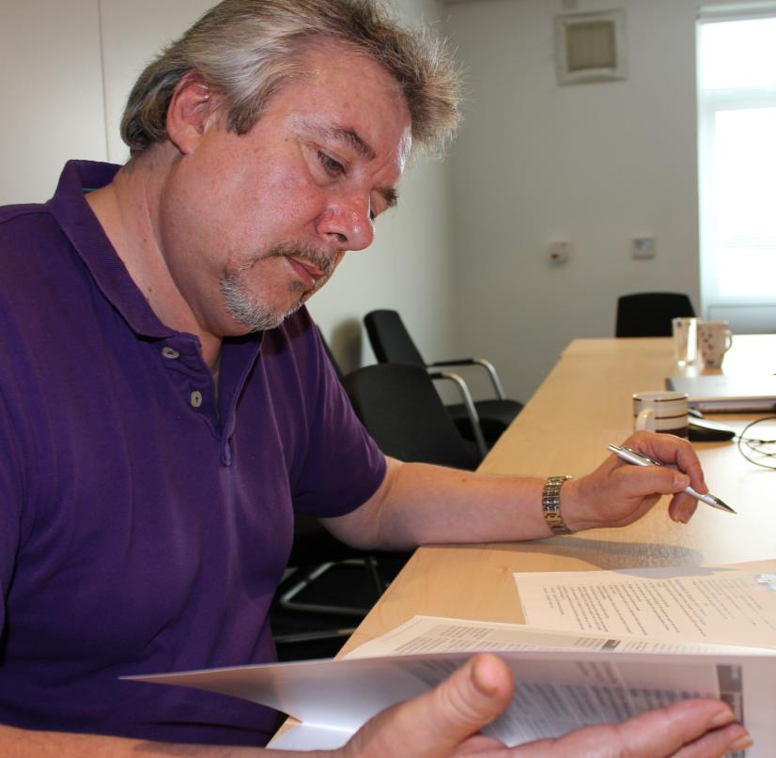
How is it assessed?
Assessment of knowledge and competence
Each standard must be completed and assessed before you can work out of your supervisor’s line of sight.

Slide 10
Key terminology (Activities)
Demonstrate - to show how a task is completed in the course of real work or a simulated activity
Describe - to describe means to create a picture with words but not simply writing a list of bullet points
List - this term means to identify the main points which can be written as bullet points
Explain - to explain something you will need to provide a clear account of your understanding, including details like why and how.

Slide 11
Key
Key term
Activity
Knowledge check
Return to contents page

Slide 12
Contents
STANDARD
1
9
Awareness of mental health, dementia and learning disabilities
Understand your role
2
10
Safeguarding adults
Your personal development
3
11
Safeguarding children
Duty of care
4
12
Basic life support
Equality and diversity
5
13
Health and safety
Person centred values
6
14
Handling information
Communication
7
15
Infection prevention and control
Privacy and dignity
8
Fluids and nutrition

